Slide 1
Iron Isotopes in Achondrite Meteorites
By Elizabeth Dybal
Mentor Meenakshi Wadhwa

Slide 2
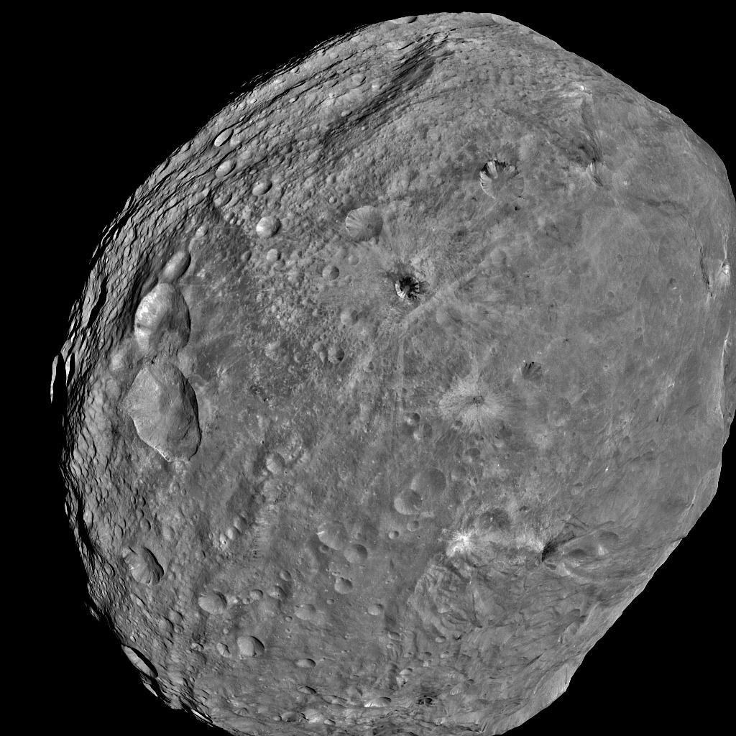
Motivation
HEDs are a group of basaltic meteorites which are believed to come from large asteroids, such as Vesta.
Fe isotopes can potentially provide information about planetesimal accretion and differentiation in the early Solar System.
The goal of this work is to expand on previously published research which concluded that:
  Partial melts from a silicate reservoir seem to be systematically isotopically heavier than their mantle protoliths (Weyer et al., 2005)
  Fe isotopes among HEDs are confined to a relatively narrow isotope range.
  The solar system was broadly homogenous in Fe isotope composition (Zhu et al. 2001)
NASA orbital mosaic of 4-Vesta

Slide 3
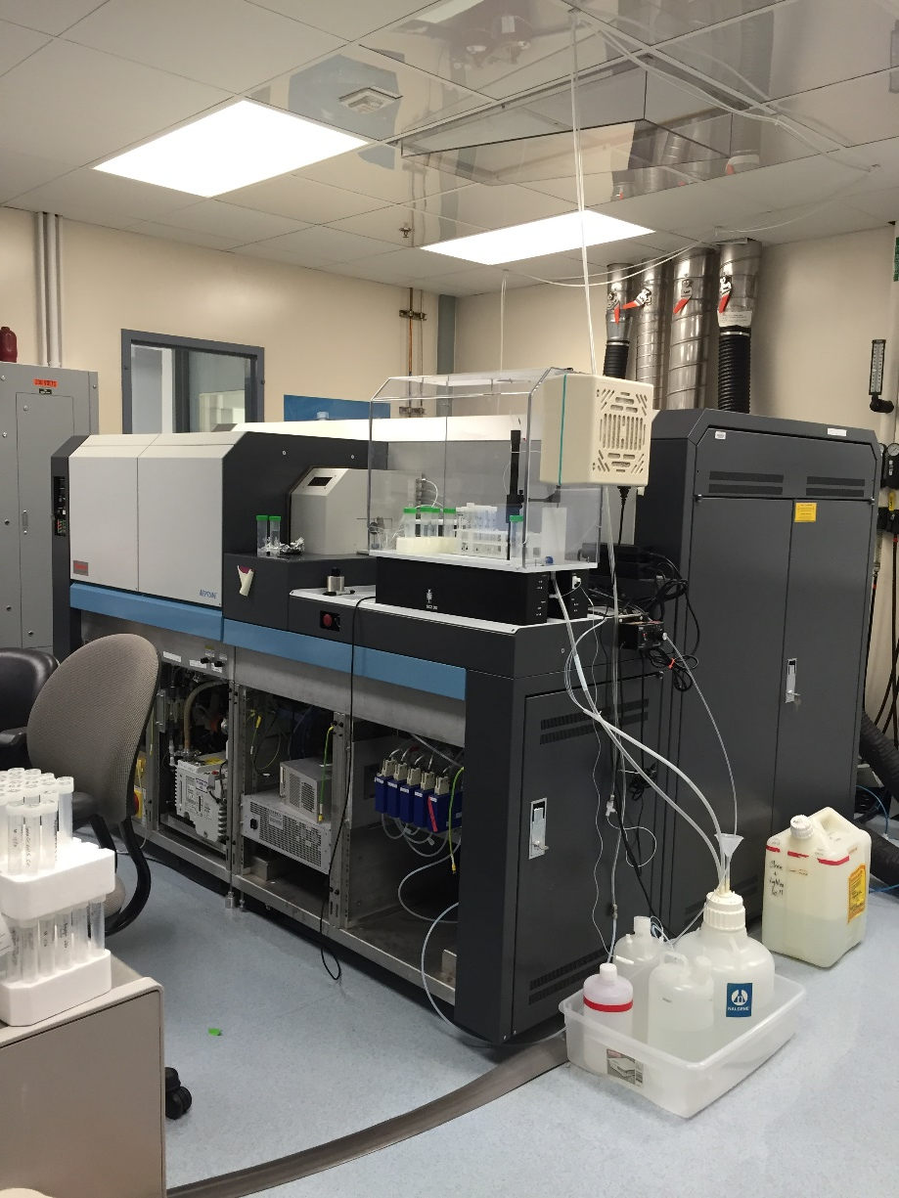
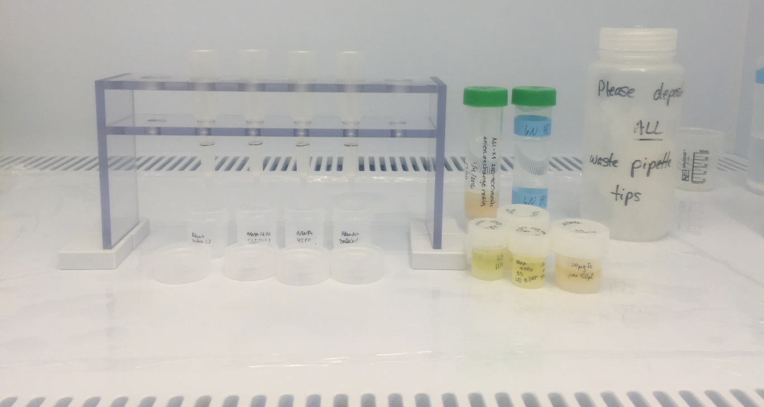
Methods
Samples were crushed and dissolved using HNO₃/HF in a high pressure Parr bomb.
Fe was purified using anion exchange chemistry.
Fe isotopes were measured using a Thermo Neptune multicollector plasma mass spectrometer in medium resolution mode using IRMM-014 as a standard.

Slide 4
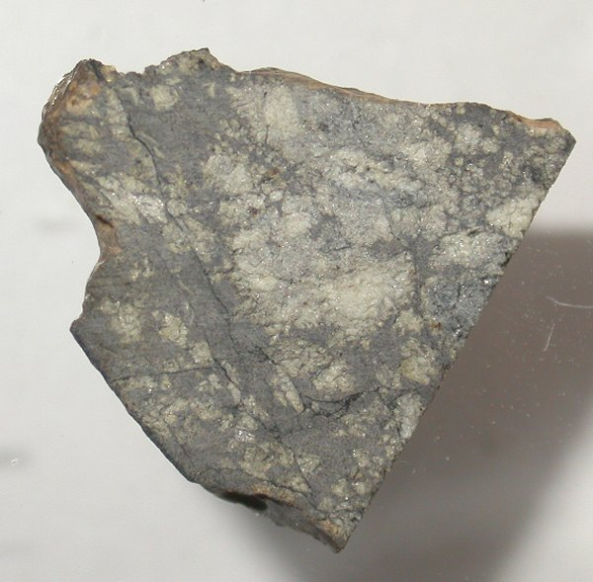
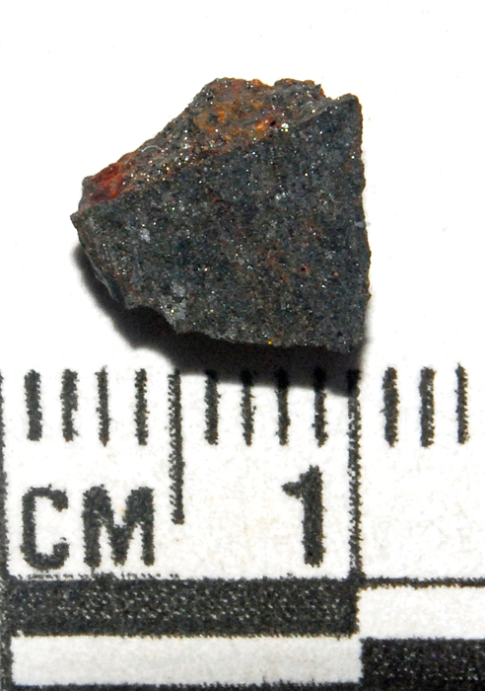
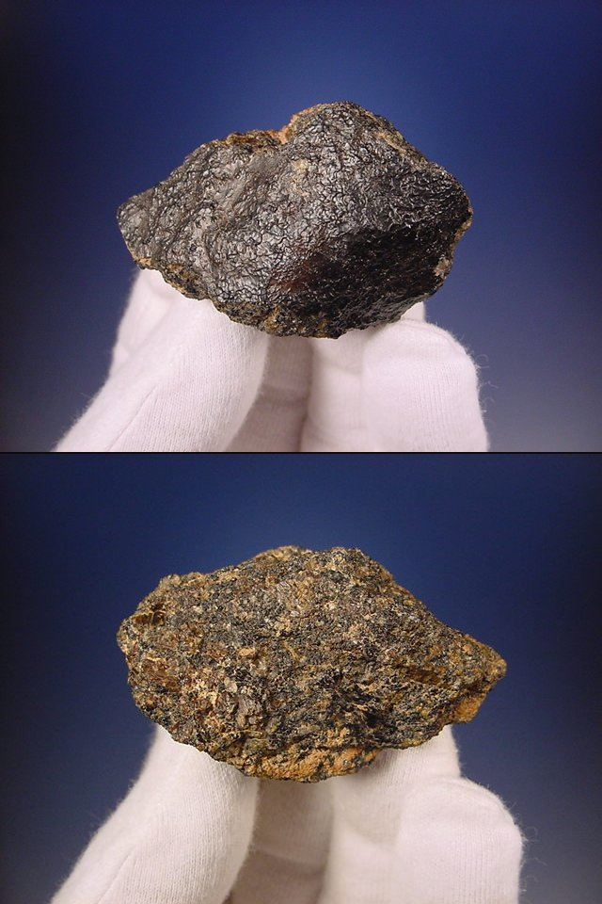
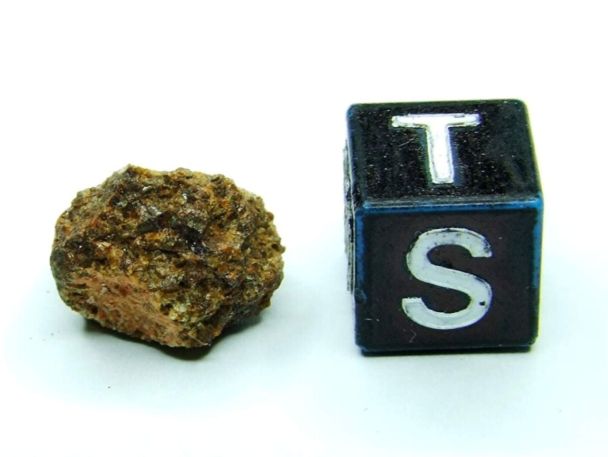
Samples
Name | Type
NWA 1670 | Angrite-Quenched
NWA 2999 | Angrite-Plutonic
NWA 4590 | Angrite- Plutonic
NWA 2976 | Ungrouped-Basaltic
Meteorites left to right: NWA 1670, NWA 2999, NWA 4590, and NWA 2976
Notes:
NWA 4590: similar to LEW 86010 minerology wise and shows fast cooling that is considered for sub-volcanic. (http://www.meteoritestudies.com/protected_NWA4590.HTM)
NWA 1670: may have had some shock

Slide 5
Geostandards
BCR-2
(This Study)
Allende
(This Study)
Allende (Literature)

Slide 6
Notes:
Previous Eurcites near zero compared to the angrites. NWA 4590 much higher than other angrites-do to formation????

Slide 7
Conclusions/Further Research
The achondrites measured in this study are isotopically heavy compared to previously published values.
  More similar to average terrestrial basalts.
The Fe isotope composition of NWA 4590 is unique among HEDs and other angrites.
  Isotopically much heavier than nearly previously reported igneous rocks.
  This could be an extremely important finding, but needs to be verified by repeat analysis.
Expand this data set to include additional angrites, as well as new meteorites classes, for which Fe isotope variations have not been studied.

Slide 8
References
Craddock, Paul R., and Nicolas Dauphas. "Iron Isotopic Compositions of Geological Reference Materials and Chondrites." Geostandards and Geoanalytical Research 35.1 (2010): 101-23. Web. 1 Apr. 2016.
Dauphas, Nicolas, Philip E. Janney, Ruslan A. Mendybaev, Meenakshi Wadhwa, Frank M. Richter, Andrew M. Davis, Mark Van Zuilen, Rebekah Hines, and C. Nicole Foley. "Chromatographic Separation and Multicollection-ICPMS Analysis of Iron. Investigating Mass-Dependent and -Independent Isotope Effects." Analytical Chemistry Anal.
Poitrasson, Franck. "Does Planetary Differentiation Really Fractionate Iron Isotopes?" Earth and Planetary Science Letters 256.3-4 (2007): 484-92. Web. 6 Feb. 2015. Chem.76.19 (2004): 5855-863. Web. 16 Sept. 2015.
Poitrasson, Franck, Alexander N. Halliday, Der-Chuen Lee, Sylvain Levasseur, and Nadya Teutsch. "Iron Isotope Differences between Earth, Moon, Mars and Vesta as Possible Records of Contrasted Accretion Mechanisms." Earth and Planetary Science Letters 223.3-4 (2004): 253-66. Web. 12 Sept. 2015.
Wang, Kun, Frédéric Moynier, Nicolas Dauphas, Jean-Alix Barrat, Paul Craddock, and Corliss K. Sio. "Iron Isotope Fractionation in Planetary Crusts." Geochimica Et Cosmochimica Acta 89 (2012): 31-45. Web. 6 Mar. 2016.
Weyer, S., A. Anbar, G. Brey, C. Munker, K. Mezger, and A. Woodland. "Iron Isotope Fractionation during Planetary Differentiation." Earth and Planetary Science Letters 240.2 (2005): 251-64. ScienceDirect. Web. 25 Jan. 2016. <http://www.sciencedirect.com.ezproxy1.lib.asu.edu/science/article/pii/S0012821X05006163>.
Zhu, X. K., Y. Guo, R. K. O'Nions, E. D. Young, and R. D. Ash. "Isotopic Homogeneity of Iron in the Early Solar Nebula." Letters to Nature 412.6844 (2001): 311-13. Nature. Macmillan Publishers Limited. Web. 25 Jan. 2016. <http://www.nature.com.ezproxy1.lib.asu.edu/nature/journal/v412/n6844/full/412311a0.html>.

Slide 9
Data
Samples | δ56/54Fe | 2sd* | δ57/54Fe | 2sd* | Δ57/54Fe | 2sd*
Allende | 0.01 | 0.05 | 0.05 | 0.08 | 0.01 | 0.01
BCR-2 | 0.19 | 0.05 | 0.3 | 0.08 | 0.01 | 0.01
NWA 1670 | 0.14 | 0.05 | 0.22 | 0.08 | 0.01 | 0.01
NWA 2999 | 0.12 | 0.05 | 0.16 | 0.08 | 0.01 | 0.01
NWA 4590 | 0.79 | 0.05 | 1.17 | 0.08 | 0.01 | 0.01
NWA 2976 | 0.14 | 0.05 | 0.18 | 0.08 | 0.01 | 0.01
*2sd based of IRMM-14 at 250 ppb with n=22
Notes:
Cu-dopping corrected/nomalized

